Slide 1
Future Institute of Engineering and Management
(Affiliated to Maulana Abul Kalam Azad University of Technology)
Kolkata-700150
Students Attendance System Using Face Recognition
B.Tech. in CSE(Data Science)
Souradip Mukherjee-(14830520020)
Jagriti Mandal-(14830520014)
Mizan Khizer -(14830520004)
Kaniska Bayan-(14830520013)
Under guidance of
Prof. Sabari kumar
CSE(DS)

Slide 2
Attendance Automation: The Power of Facial Recognition in Education
The use of advanced face recognition technology has revolutionized attendance systems, providing a seamless and secure solution for organizations.

Slide 3
What is Face Recognition Technology?
Face Recognition system is an advanced and automated attendance system that can identify a person by facial features.

Slide 4
The Benefits of an Advanced Face Recognition Attendance System
Accuracy : Face recognition ensures highly accurate attendance records, eliminating buddy punching and unauthorized access.
Convenience : Students can quickly and effortlessly check-in or check-out using their faces, saving time and reducing queues.
Enhanced Security : Face recognition provides a robust security measure, preventing impersonation and unauthorized entry.
Data Insights : The system collects valuable data, enabling organizations to analyze attendance patterns and optimize resource allocation.

Slide 5
DEPLOYMENT OR HOW TO USE THIS SYSTEM
1.Login
3. Train face dataset
2.Student data and photo collection
4.Face detection
5.Face Recognition
6.Collect Attendance

Slide 6
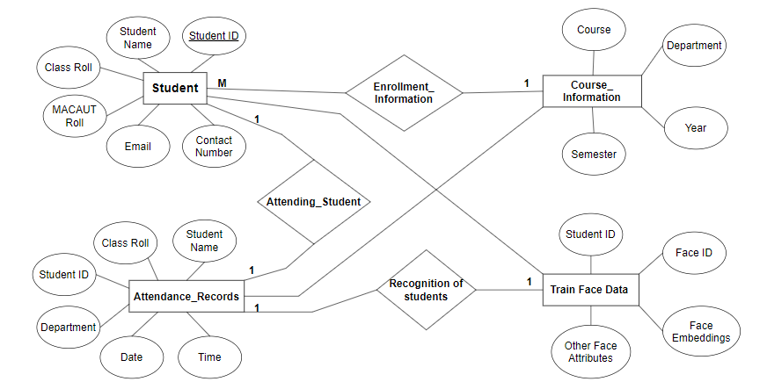
Entity-Relation Diagram of Face Recognition System

Slide 7
ALGORITHM USED IN OUR PROPOSED SYSTEM : CNN (Convolutional Neural Network )
CNNs are deep learning models specifically designed for processing visual data like images and videos.
They excel at tasks such as image classification, object detection, and image segmentation.
CNNs leverage parameter sharing to efficiently learn from spatially invariant features in images.

Slide 8
Libraries
Tkinter :
Numpy:
Face-recognition:
Opencv:
Os:
Pillow:
json:
Datetime:
Mysql.connector:
Pandas:

Slide 9

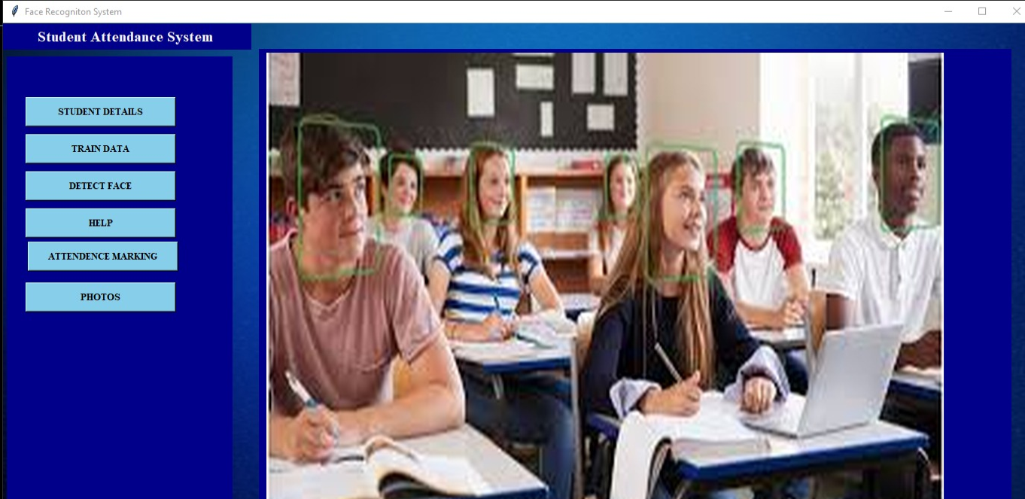
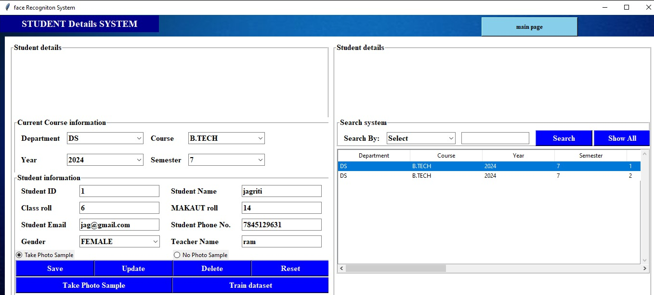
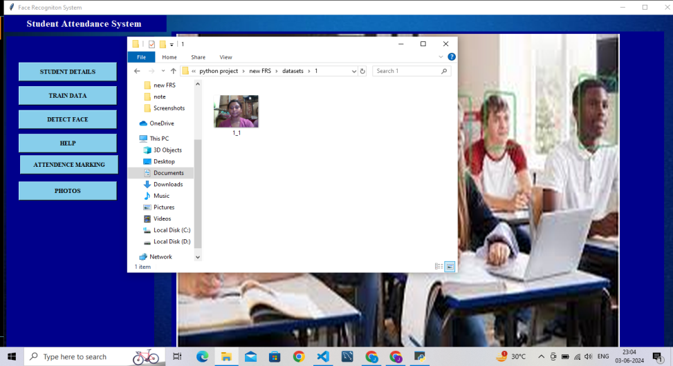
Implementation(Screenshots)
Login page
Main page
Student page
Image data collection

Slide 10
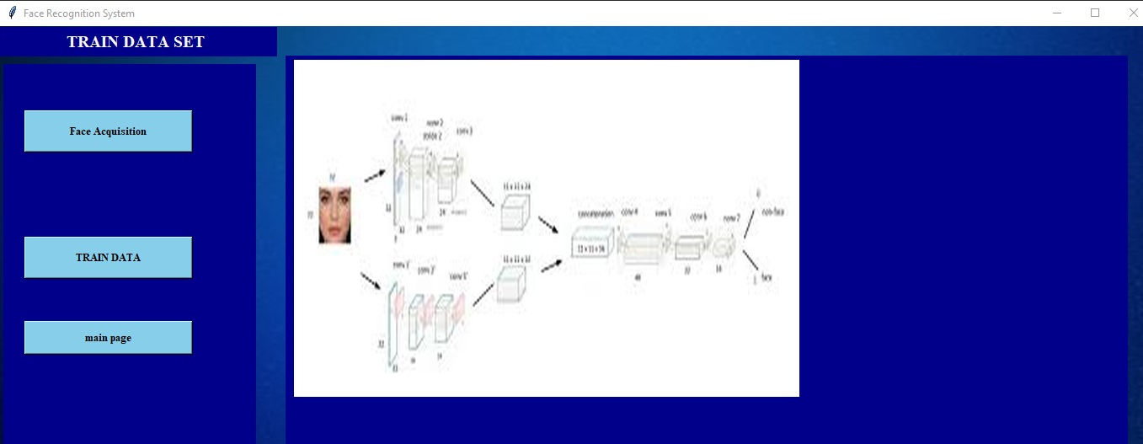
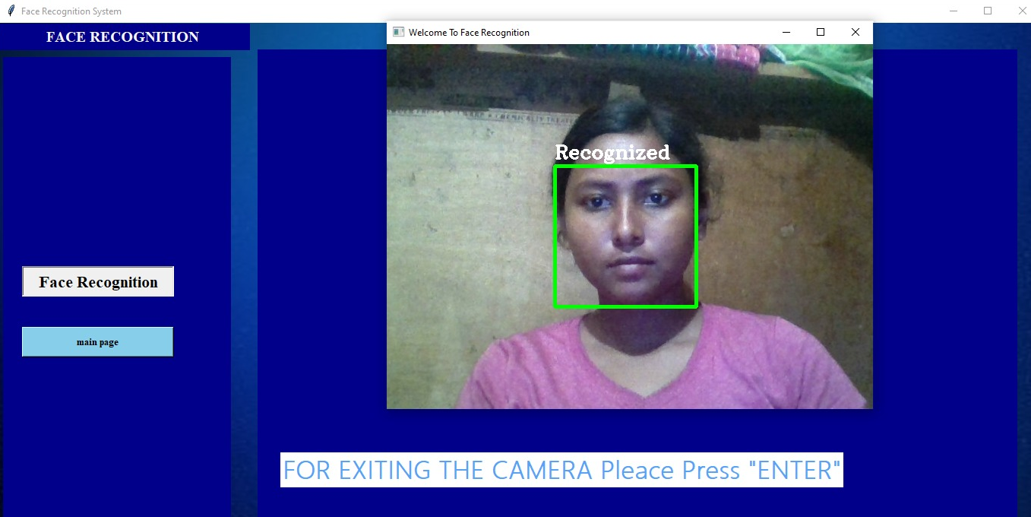
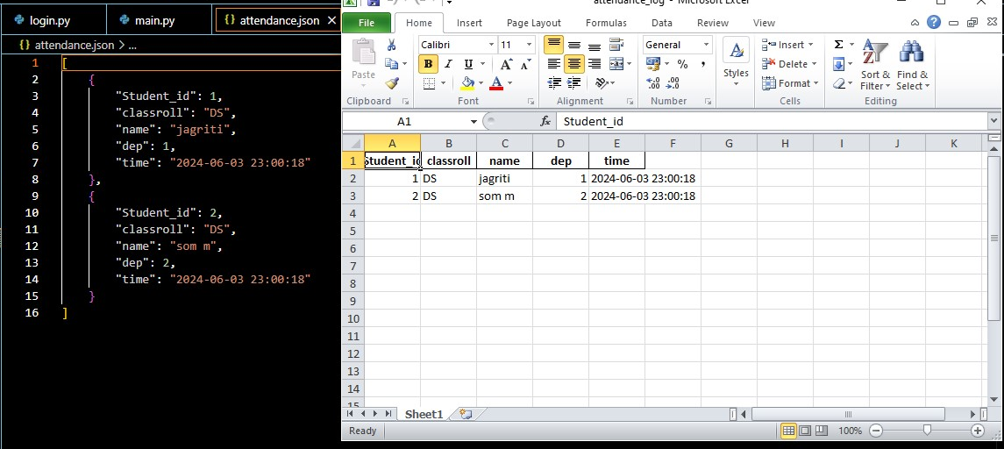
Implementation(Screenshots)
Training page
Face Recognition page
Attendance collection page

Slide 11
Conclusion: The Future of Face Recognition Attendance Systems
Face recognition attendance systems are continually evolving, becoming more sophisticated and seamlessly integrated into the fabric of modern organizations.

